Slide 1
GH-100: GitHub Fundamentals - Administration basics and product features Part 2
GitHub Fundamentals - Administration basics and product features
- Part 2
Notes:
https://learn.microsoft.com/en-us/training/paths/github-admin-2/github-admin-2

Slide 2
Module 6: Authenticate and authorize user identities on GitHub
Module 6: Authenticate and authorize user identities on GitHub
Notes:
Title: Module 6: Authenticate and authorize user identities on GitHub
Learning Objectives:
By the end of this unit, you'll be able to:
Be able to describe the Authentication and Authorization Model.
Understand how to manage user access to your GitHub organization through Authorization and Authentication tools.
Identify the supported identity providers and technologies that support secure repository access.
Understand the implications of enabling SAML SSO.
Identify the authorization and authentication options available, and understand the administrator's role in enforcement of a secure access strategy for a GitHub enterprise.
Describe how users access private information in a GitHub organization.
Evaluate the benefits of enabling Team Synchronization to manage team membership.
Module Units
Introduction2 min
User identity and access management4 min
User authentication10 min
User authorization7 min
Team synchronization5 min
Module assessment3 min
Summary2 min

Slide 3
Introduction
In this unit, you will learn how to strengthen account security in your GitHub organization by implementing advanced authentication and authorization methods. We’ll cover multi‑factor authentication, SAML single sign‑on, Enterprise Managed Users, and auditing tools to enforce policies and monitor user access and activity.
By the end of this unit, you'll be able to:
Describe GitHub’s authentication and authorization framework—including available methods (personal tokens, SSH, SAML SSO, Enterprise Managed Users) and the administrator’s role in enforcing secure access.
Manage user and team access to your organization and private repositories using identity providers (e.g., SAML SSO), Team Synchronization, and built‑in auth tools.
Explain how users access private organization resources and apply best practices to protect sensitive data.
Notes:
Welcome to this unit on strengthening account security in GitHub. Today, we’ll explore the advanced authentication and authorization tools you can use to safeguard your organization’s repositories—from multi‑factor authentication and SAML single sign‑on to Enterprise Managed Users and audit logging. You’ll learn not only how to configure these features, but also how to enforce them across your teams and monitor access activity for compliance and peace of mind.
Our learning objectives are:
Describe GitHub’s authentication and authorization framework.
We’ll review each method—personal access tokens, SSH keys, SAML SSO, and Enterprise Managed Users—and discuss the administrator’s role in setting policies, requiring two‑factor authentication, and ensuring only authorized users can sign in.
Manage user and team access using identity providers and built‑in tools.
You’ll see how to integrate SAML single sign‑on or SCIM for automated provisioning, synchronize GitHub teams with your IdP, and use GitHub’s native controls to grant or revoke access at both the user and team levels.
Explain how users access private organization resources and apply best practices to protect sensitive data.
Finally, we’ll cover how permissions translate into actual repository access, how to audit that access via logs and reports, and which patterns—like least‑privilege and credential rotation—help you keep your most critical information secure.
By the end of this session, you’ll have a clear, actionable roadmap for implementing a robust, enterprise‑grade security model in GitHub that balances strict protection with a seamless developer experience.

Slide 4
User identity and access management
Authentication is the gateway to your enterprise's software development ecosystem. Every user's interaction with GitHub begins with identity verification. While individual accounts can rely on usernames and passwords, strong enterprise security mandates two-factor authentication (2FA) or more advanced methods like passkeys and biometric login. Balancing usability with security is key—especially in a fast-paced development environment.
Notes:
Authentication is truly the front door to your enterprise’s development ecosystem. It’s the very first check every user must pass before they can interact with code, issues, pull requests, or any other resource in GitHub. If that front door is weak, an attacker could walk right in—and that’s why we need to go beyond simple usernames and passwords.

Slide 5




To ensure a secure and streamlined authentication experience, GitHub supports multiple modern methods that integrate with your identity management systems:
Modern Authentication in GitHub Enterprise
Passkeys & WebAuthn
GitHub Mobile for Authentication
Passkeys: A modern authentication method that replaces passwords with device-based security keys.
WebAuthn: Supports biometric authentication and hardware security keys for enhanced security.
Benefit: Reduces reliance on traditional credentials, mitigating phishing risks.
Users can leverage GitHub Mobile as a second factor for authentication.
Provides push-based authentication approval for added security.
OAuth App & GitHub App Authentication
Enterprise Managed Users (EMU)
OAuth Apps: Authenticate users through GitHub's OAuth 2.0 protocol.
GitHub Apps: Authenticate as individual installations with granular permissions.
OAuth Flow: Covers authorization code grant and device flow for external integrations.
Available in GitHub Enterprise Cloud to enforce authentication through Identity Providers (IdP).
Restricts sign-in to enterprise-managed identities, enhancing access control.
Notes:
Passkeys & WebAuthn
GitHub supports modern, phishing-resistant authentication methods, including:
Passkeys: These replace passwords with device-based credentials, such as Face ID, Touch ID, or PINs tied to your device.
WebAuthn: Enables biometric authentication or physical security keys (like YubiKey), offering a high level of protection against account takeovers.
These tools reduce reliance on traditional passwords and significantly lower the risk of phishing attacks or password leaks.
GitHub Mobile for Authentication
GitHub Mobile can be used as a second authentication factor, providing push notifications to confirm login attempts. It’s a convenient, secure method for users who prefer mobile-based 2FA over SMS or apps like Authenticator.
OAuth App & GitHub App Authentication
There are two primary app models for integration:
OAuth Apps use GitHub’s OAuth 2.0 protocol to authenticate users. They’re commonly used in external integrations and support flows like the authorization code grant and device flow.
GitHub Apps authenticate on behalf of an installation, not a user, and offer granular, per-repo permissions—making them ideal for automation or bots with limited scopes.
Understanding these flows helps teams select the right method for integrating third-party tools securely.
Enterprise Managed Users (EMU)
For organizations using GitHub Enterprise Cloud, Enterprise Managed Users (EMUs) allow all accounts to be provisioned and authenticated exclusively through an identity provider (IdP).
This means:
No personal GitHub accounts.
Complete control over user access and lifecycle management.
Stronger compliance and enforcement of SSO policies.

Slide 6
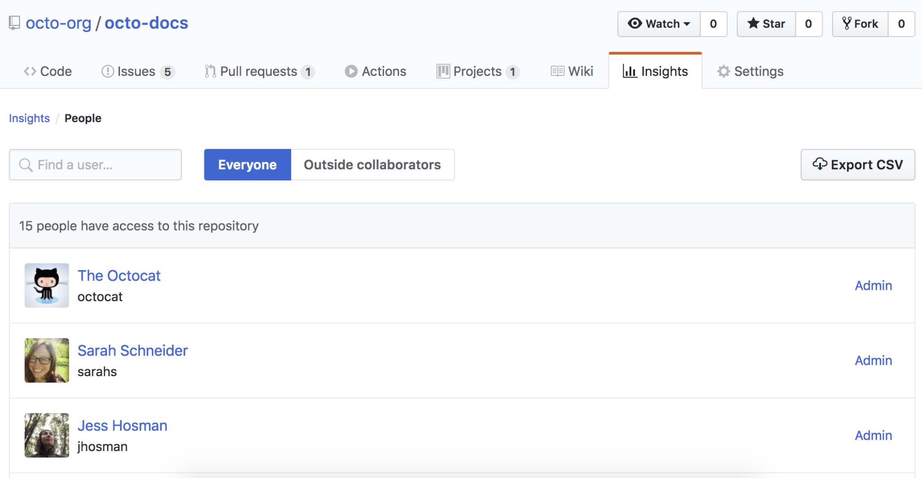
Organization Management with SAML SSO
One foundational capability for enterprise-grade authentication is SAML Single Sign-On (SSO). SAML links your IdP with GitHub, enabling users to sign in across services using one set of credentials. GitHub uses the IdP to verify user identity before granting access to organization or enterprise resources.
When users log into GitHub, they can see the enterprises they belong to—but access to repository data requires SAML reauthentication via the IdP.
As an Enterprise Admin, your responsibilities include:
Authorizing access based on role and need-to-know.
Monitoring and auditing user activity.
Scoping permissions and minimizing surface area for attacks.
Notes:
SAML Single Sign‑On is the cornerstone of enterprise‑grade authentication in GitHub. By linking your corporate Identity Provider—whether that’s Azure AD, Okta, or another SAML 2.0 service—to GitHub, you give your users a seamless, secure login experience. They authenticate once with your IdP and then gain access to all your enterprise resources without juggling separate GitHub credentials.
When a user signs into github.com, they’ll see the list of enterprises and organizations they belong to—but to actually interact with any repository or team data, GitHub challenges them to reauthenticate through your IdP. This step ensures that every access to sensitive code is backed by your corporate authentication policies—like enforced 2FA or device compliance checks.
As an Enterprise Admin, your key duties include:
Authorizing access by role and need‑to‑know: Map your IdP groups to GitHub teams and organizational roles so users only gain the permissions they require—no more, no less.
Monitoring and auditing user activity: Use GitHub’s audit logs to verify who’s accessing what, when, and from where. Correlate these logs with your IdP’s sign‑in records to spot anomalies or suspicious login attempts.
Scoping permissions and minimizing attack surface: Combine SAML SSO with least‑privilege principles—limit broad admin rights, restrict branch‑protection bypass to only essential users, and regularly review group memberships to remove stale access.
By centralizing authentication in your IdP and enforcing SAML SSO, you maintain a single source of truth for user identities, simplify compliance reporting, and dramatically reduce the risk of credential compromise across your entire GitHub Enterprise deployment.

Slide 7
Configure SAML SSO
To configure SAML SSO for your organization, integrate your IdP with GitHub. Supported providers include:
Active Directory Federation Services (AD FS)
Microsoft Entra ID
Okta
OneLogin
PingOne
Shibboleth
Note: GitHub provides limited support for identity providers that implement the SAML 2.0 standard.
Notes:
GitHub’s SAML SSO works with any provider that implements the SAML 2.0 standard, giving you flexibility to integrate with your existing identity infrastructure. Here are the officially supported options:
Active Directory Federation Services (AD FS)
Microsoft Entra ID
Okta
OneLogin
PingOne
Shibboleth
Note: While GitHub can connect to any SAML 2.0–compliant IdP, these providers receive additional support and documentation to streamline your setup.

Slide 8



Access in GitHub is governed by a robust, multi-layered authorization model:
Enterprise Access and Authorization Controls
Fine-Grained Personal Access Tokens (PATs)
Custom Repository Roles
Fine-grained PATs provide better security by limiting access to specific repositories and permissions.
Unlike classic PATs, they support expiration dates and enhanced control.
Organizations can create custom roles with fine-grained permissions beyond default roles.
Enables precise control over repository access for different user groups.
Security Policies for Access Management
Organization and Enterprise-Level Access Controls
Organizations can enforce security policies to:
Require 2FA for all users.
Restrict access based on IP allowlists.
Block unverified third-party OAuth apps unless explicitly approved.
Org-Level Permissions: Team-based access control, outside collaborators, and default roles.
Enterprise-Level Controls:
Enterprise owners enforce SAML SSO, IdP-based authentication, and security policies.
Centralized user management with GitHub Enterprise Cloud.
Notes:
Fine-Grained Personal Access Tokens
GitHub now supports fine-grained PATs, which offer:
Limited access to specific repositories and actions
Support for expiration dates
Improved auditability and revocation control
They’re a safer alternative to classic PATs, especially for automation scripts and CI/CD tools.
Custom Repository Roles
Organizations can now define custom roles with very specific permissions beyond GitHub’s default roles (e.g., Admin, Maintainer, Read).
This allows you to:
Assign only the access someone needs (principle of least privilege)
Define roles like “triager” or “release manager” that align to your workflows
It’s a powerful tool for access governance.
Security Policies for Access Management
GitHub supports enforcement of security policies, including:
Mandatory 2FA for all org members
IP allowlists for controlling where users can authenticate from
Blocking unverified third-party OAuth apps
These policies help prevent unauthorized access and are highly recommended for any production organization.
Organization and Enterprise-Level Access Controls
At the org level, access can be managed through:
Teams
Outside collaborators
Default roles
At the enterprise level, admins can enforce global policies like:
SAML SSO
SCIM provisioning
IdP-based authentication
These controls give enterprise owners centralized visibility and enforcement across all organizations under their GitHub Enterprise account.
Finally, GitHub gives you three visibility tiers for repositories:
Public, which is open to anyone online,
Private, restricted to explicitly granted users, and
Internal, visible to every member of your enterprise but hidden from external collaborators.
This granularity means you can share open‑source projects widely, keep core corporate code under tight lock and key, or collaborate internally across multiple teams without exposing sensitive assets to outside users.

Slide 9
User authentication
When it comes to user authentication, security should be the number one consideration that comes to mind. Strong security is essential. It seems like every month or so, a company reports a data breach. Credentials are stolen because of inefficient security processes, or simply because of a lack of up-to-date security features within the company. Establishing secure user authentication can be a difficult task if user adoption requires long and frustrating steps to authenticate.
GitHub Enterprise supports two recommended methods for secure user authentication:
SAML Single Sign-On(SSO)
Two-Factor Authentication(2FA)
Notes:
Every month, we hear about another data breach caused by weak or outdated security processes—often stemming from compromised credentials. That’s why strong authentication must be our top priority. Yet, security shouldn’t mean friction. If your developers dread the login process, they’ll look for shortcuts that undermine your defenses.
GitHub Enterprise offers two recommended methods that strike the right balance between robust protection and usability:
SAML Single Sign‑On (SSO):
Integrates GitHub with your corporate identity provider so users sign in once to your trusted system, then access GitHub without entering separate credentials.
Centralizes policy enforcement—like password complexity and session timeouts—while delivering a seamless experience.
Two‑Factor Authentication (2FA):
Adds a second factor—an OTP from an authenticator app, SMS code, or hardware security key—on top of a password, dramatically reducing the risk of account takeover.
Can be enforced organization‑wide, ensuring every contributor secures their account with a second layer of verification.
By combining SAML SSO with mandatory 2FA, you get enterprise‑grade security without slowing down your teams—keeping your code and your users protected.

Slide 10
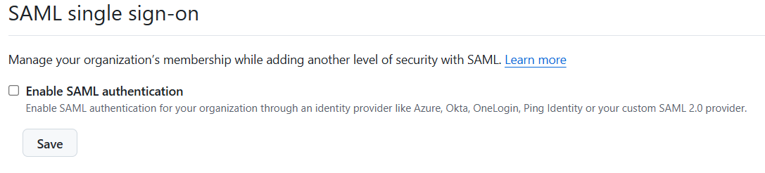
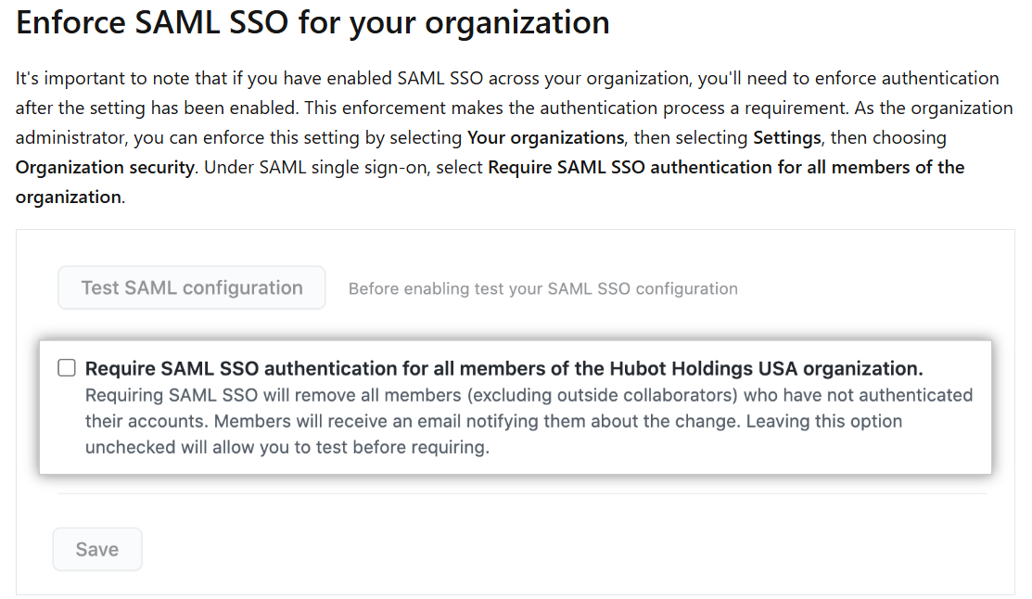
Enabling and Enforcing SAML SSO
Organization-Level SAML SSO
Step | Description
1. Prepare Your Organization | Review your organization's membership to ensure all members have accounts linked to your Identity Provider (IdP). Enable SAML SSO and review members' SAML access.
2. Enable SAML SSO | In the upper-right corner of GitHub, click your profile photo, then select Your organizations. Choose the organization you want to configure. Click Settings > Security. Under SAML single sign-on, click Enable SAML SSO. Enter your IdP's SAML SSO URL and the Public Certificate. Click Test SAML configuration to ensure the settings are correct. Click Save to apply the configuration.
3. Enforce SAML SSO | In the Security settings, under SAML single sign-on, select Require SAML SSO authentication for all members of the organization. Review the list of members who haven't authenticated via your IdP. Click Remove members and require SAML single sign-on to enforce the policy.
Note: GitHub provides limited support for identity providers that implement the SAML 2.0 standard.
Notes:
Let’s start with enabling SAML SSO for just one organization within your enterprise. This is a common first step if you want to pilot SSO before rolling it out enterprise-wide.
Step 1 is preparation. You’ll want to make sure all organization members have accounts that are linked to your Identity Provider. This is critical, because once enforcement is turned on, GitHub will remove users who haven’t authenticated via the IdP.
Step 2 is enabling SAML SSO. From your GitHub profile, go to “Your organizations”, select the correct org, and head to Settings > Security. From there, you’ll see the option to Enable SAML SSO. You’ll need to enter your IdP’s SAML SSO URL and the public certificate, then test the configuration before saving.
Step 3 is enforcement. Once you’ve verified that users are properly linked and the SSO works, go back into security settings and require SAML SSO. GitHub will show you a list of users who haven’t authenticated. You can then remove them automatically and enforce the policy going forward.
This org-level approach gives you more flexibility and is useful for a phased rollout.

Slide 11
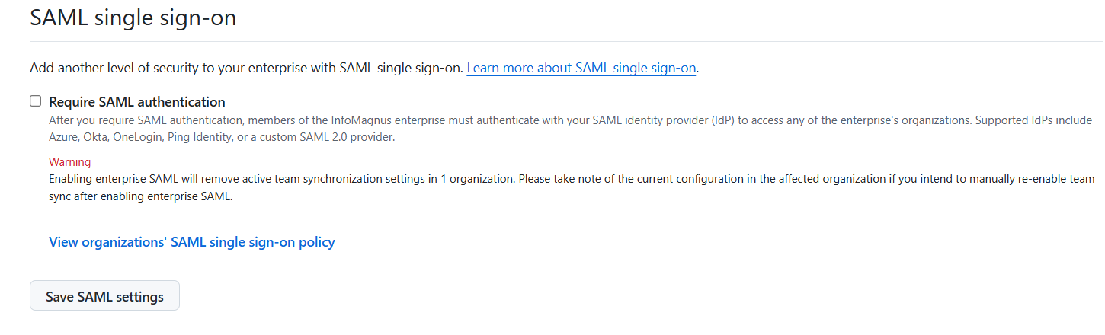
Enabling and Enforcing SAML SSO
Enterprise-Level SAML SSO
Step | Description
1. Enable SAML SSO for the Enterprise | In the upper-right corner of GitHub, click your profile photo, then select Your enterprises. Choose the enterprise account you want to configure. Click Settings > Security. Under SAML single sign-on, click Enable SAML SSO. Enter your IdP's SAML SSO URL and the Public Certificate. Click Test SAML configuration to ensure the settings are correct. Click Save to apply the configuration.
2. Enforce SAML SSO for All Organizations | In the Security settings, under SAML single sign-on, select Require SAML SSO authentication for all members of the enterprise. Review the list of members who haven't authenticated via your IdP. Click Remove members and require SAML single sign-on to enforce the policy.
Notes:
Next, let’s walk through enabling SAML SSO at the enterprise level—meaning it will apply to all organizations under your GitHub Enterprise account.
Step 1: Enable SAML SSO for the enterprise. From your GitHub profile, select “Your enterprises”, choose the appropriate account, and go to Settings > Security. Just like with the org-level setup, you’ll enter your SAML SSO URL and public certificate, then test and save the configuration.
Step 2: Enforce SAML SSO for the enterprise. Once the setup is tested, you can require all enterprise members to authenticate via your IdP. However, there’s an important distinction here: GitHub does not automatically remove users at the enterprise level if they haven’t authenticated. Instead, the next time they try to access any enterprise resource, they’ll be prompted to sign in through your IdP.
This approach provides unified authentication across all organizations, but requires careful preparation to ensure every user is properly onboarded beforehand.

Slide 12
Choosing the Right SSO Scope
Criteria | Org-Level | Enterprise-Level
Scope | Individual organization | Entire enterprise
User Removal | Immediate upon enforcement | Deferred until next access
Policy Consistency | Varies by org | Unified across enterprise
Setup Complexity | Lower | Higher
Use Case | Pilot/test | Broad compliance
Notes:
When planning SAML SSO, you have two deployment scopes to consider—organization‑level or enterprise‑level—each with distinct trade‑offs:
Scope:
Organization‑level SSO affects just one GitHub organization, making it ideal for pilots or non‑critical teams.
Enterprise‑level SSO covers every org under your enterprise account, ensuring a single sign‑on experience across all projects.
User Removal:
With org‑level SSO, users are immediately blocked from that org as soon as you enforce SAML.
At the enterprise level, enforcement is deferred until the next time users access any enterprise resource, giving them a small grace period.
Policy Consistency:
Org‑level settings can vary from one org to another, which is fine for testing or small teams.
Enterprise‑level policies are unified, so you apply the same SSO requirements everywhere—crucial for broad compliance mandates.
Setup Complexity:
Configuring SSO at the organization level is straightforward and low‑overhead.
Rolling out enterprise‑wide SSO involves more planning—metadata management, certificate exchanges, and coordination with multiple teams—but pays off in consistent governance.
Use Case:
Choose org‑level when you want to pilot SSO, onboard a single department, or test configurations without impacting everyone.
Opt for enterprise‑level when you need blanket compliance, a unified login flow across dozens of orgs, and centralized policy enforcement.
By weighing these criteria—scope, user impact, consistency, complexity, and use case—you can select the SSO deployment that best aligns with your organization’s size, risk profile, and change management constraints.

Slide 13
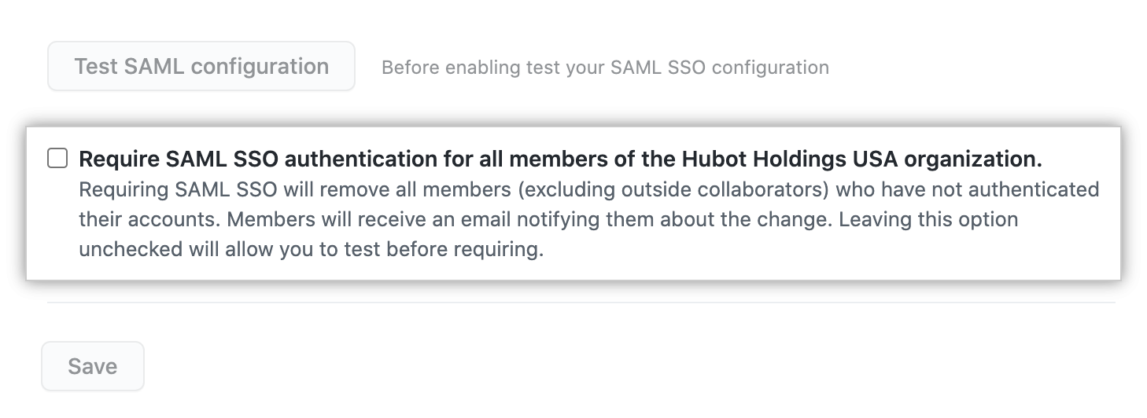
Step-by-Step: Enabling and Enforcing SAML SSO
Scope | Steps
Organization | 1. Navigate to Your organizations → Settings → Security. 2. Enable SAML with your IdP’s details. 3. Test configuration and save. 4. Select Require SAML SSO, then remove noncompliant users.
Enterprise | 1. Navigate to Your enterprises → Settings → Security. 2. Enable SAML with your IdP’s details. 3. Test configuration and save. 4. Enforce SSO across all orgs and review noncompliant users.
Notes:
When you’re ready to tighten account security, SAML Single Sign‑On is the foundation. At the organization level, navigate to your org’s Settings → Security, paste in your IdP’s SAML endpoints and X.509 certificate, then test and save. Once it’s working, switch on Require SAML SSO—this blocks anyone who hasn’t yet signed in through your IdP, so you’ll need to remove or onboard any non‑compliant users.
If you need enterprise‑wide coverage, the process is very similar but scoped at the Your enterprises level. Go to Settings → Security, configure the same SAML metadata, and verify connectivity. When you enforce SSO here, it cascades across all organizations in your enterprise, giving you one consistent authentication policy. Finally, review the list of users who haven’t yet authenticated via SAML, so you can follow up or remove their access and ensure full compliance.

Slide 14

Two-Factor Authentication (2FA)
2FA adds a second verification step beyond username and password. You can require 2FA for organization members, outside collaborators, and billing managers.
Warning: When you require the use of two-factor authentication for your organization, all accounts that don't use 2FA is removed from the organization and lose access to its repositories. Accounts that are affected include bot accounts.
For more detailed information about 2FA, see Securing your account with two-factor authentication (2FA).
Notes:
Two‑Factor Authentication, or 2FA, adds a second verification step on top of your username and password—typically a one‑time code from an authenticator app, SMS message, or hardware security key. Enabling 2FA dramatically reduces the risk of account takeover, even if a password is compromised.
On GitHub, you can require 2FA for all organization members, outside collaborators, and billing managers—ensuring that everyone who can access your code is protected by this extra layer.
Warning: When you enforce 2FA at the organization level, any account that hasn’t enabled 2FA is automatically removed from the organization and loses access to its repositories. This includes bot and service accounts, so be sure to update or replace those credentials beforehand to avoid workflow interruptions.
For a step‑by‑step guide on setting up 2FA for your user account, see the “Securing your account with two‑factor authentication (2FA)” documentation.

Slide 15
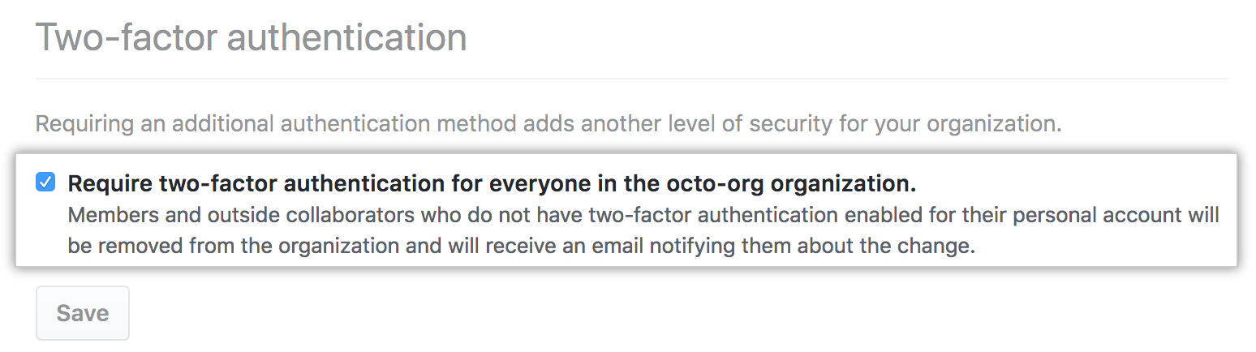
Enforcing 2FA
Navigate to your org’s Security settings.
Enable the checkbox labeled Require two-factor authentication.
Communicate the requirement in advance to prevent loss of access.
2FA Methods in GitHub
Method | Description
Security Keys | Most secure method. Physical USB or NFC devices that prevent phishing. Requires prior setup with TOTP(Time-based one-time passwords) or SMS(Short Message Service).
TOTP Apps | Recommended. Generates time-based one-time passwords, supports backup, and works offline.
SMS | Least secure. Should only be used where TOTP isn't viable. GitHub SMS support varies by region.
Notes:
In order to protect every account that can touch your organization’s repositories, you should require two‑factor authentication for all members, outside collaborators, and billing managers. To do this, navigate to your organization’s Settings → Security, and simply check the box labeled Require two‑factor authentication.
Be sure to communicate this policy well in advance—any user or bot account without 2FA enabled will be automatically removed from the organization and lose access. Give everyone time to register their devices or authenticator apps so you don’t inadvertently block critical workflows.
GitHub supports three methods of two‑factor authentication, ranked here by security level:
Security Keys
The most secure option, using physical USB or NFC devices. These keys protect against phishing by requiring the user to have the hardware present at login. Note that you must set up a TOTP app or SMS fallback before you register security keys.
TOTP Apps (Time‑based One‑Time Passwords)
The recommended method for most users. Apps like GitHub Authenticator, Google Authenticator, or Authy generate one‑time codes offline, and allow backup recovery, making them both secure and convenient.
SMS (Short Message Service)
The least secure, and only to be used when TOTP isn’t possible. SMS support varies by region, and SMS messages can be intercepted, so treat this as a last resort.
By offering multiple 2FA methods, GitHub lets you balance security with user convenience—while enforcing a strong second factor across your entire organization.

Slide 16
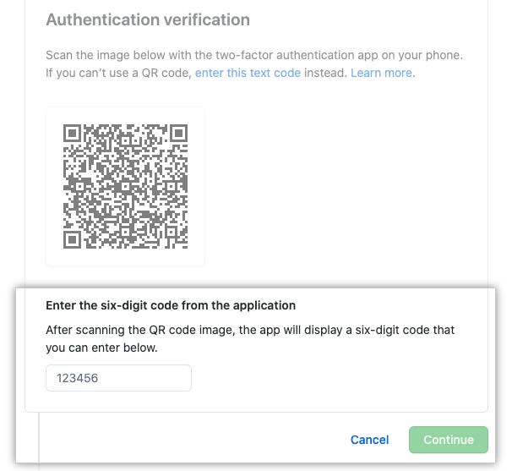
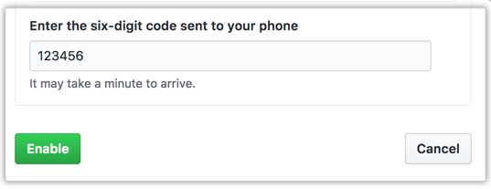
Enforcing 2FA
Time-based one-time passwords
GitHub SMS support
Note: Security keys store credentials locally and never expose secrets. GitHub recommends FIDO2/U2F keys.
Notes:
Time‑based one‑time passwords generate a unique six‑digit code every 30 seconds using an app on your device, like GitHub Authenticator, Google Authenticator, or Authy.
Users link the app to their GitHub account by scanning a QR code once; thereafter, they open the app and enter the current code at each sign‑in.
Because codes are generated locally and expire quickly, TOTP is both secure and reliable—even offline, since it doesn’t rely on network connectivity.
As a fallback option, GitHub can send one‑time codes via SMS to a verified phone number.
When TOTP isn’t viable—such as for users without a smartphone app—SMS provides a way to receive a second factor.
Be aware that SMS is inherently less secure than TOTP or security keys, and availability varies by region.
For the strongest protection, GitHub recommends using FIDO2/U2F security keys. These USB or NFC devices store private credentials entirely on the hardware and never expose them to the host system, preventing phishing and credential theft.
Always set up a TOTP app or SMS fallback before registering security keys, so you can recover access if a key is lost.

Slide 17
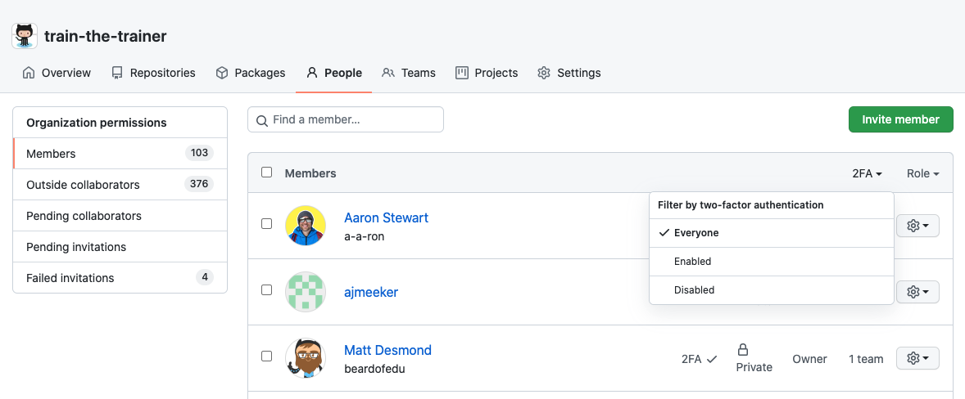
Auditing 2FA Compliance
To review who has enabled 2FA:
Go to Your organizations → select org → People tab.
Select the 2FA filter.
From here, you can identify noncompliant users and follow up outside of GitHub, typically via email.
Notes:
To ensure every member of your organization has enabled two‑factor authentication, navigate to Your organizations, select the target org, and click the People tab. There, use the 2FA filter to instantly surface anyone who hasn’t yet set up their second factor.
This view lets you quickly identify noncompliant accounts—whether they’re individual contributors or service bots—so you can reach out and guide them through the setup process, typically via direct email or your internal communications channel. Keeping this list clean is essential; any account without 2FA will be blocked once enforcement is turned on, so proactive follow‑up ensures a smooth transition and prevents unexpected access losses.

Slide 18


SCIM Integration with GitHub
SCIM streamlines identity management in GitHub Enterprise Cloud by supporting both native integrations and custom configurations.
Supported SCIM Providers
Custom SCIM Integrations
GitHub Enterprise Cloud offers native integration with the following Identity Providers (IdPs):
Okta
Azure AD
OneLogin
Ping Identity
Google Workspace
These integrations ensure reliable configuration and compatibility.
If your IdP isn't natively supported, use GitHub’s SCIM API to build custom integrations.
SCIM API Overview
GitHub's SCIM API enables programmatic management of users and groups within your organization.
The SCIM 2.0 API allows you to:
Create, update, and delete users
Manage groups
Notes:
SCIM—System for Cross‑domain Identity Management—automates user and group provisioning in GitHub Enterprise Cloud, so you can keep your directory in sync without manual effort.
GitHub offers native SCIM integrations with major identity providers, including Okta, Azure AD, OneLogin, Ping Identity, and Google Workspace. These turnkey connections streamline setup and ensure compatibility, letting you push user and team changes from your IdP directly into GitHub.
If your IdP isn’t on that list, you can still leverage GitHub’s SCIM API for a custom integration. The SCIM 2.0 API supports creating, updating, and deleting users, as well as managing group memberships. By scripting against these endpoints, you can build a bespoke provisioning flow that fits your environment—whether that’s an in‑house directory or a specialized third‑party identity service.
Together, native and custom SCIM options give you flexible, scalable identity management: onboard new hires, update role changes, and remove departing users automatically—keeping your GitHub enterprise secure and up to date without manual administration.

Slide 19
Example Request to Provision a User:
POST /scim/v2/Users
Content-Type: application/json
{
"userName": "jdoe",
"name": {
"givenName": "John",
"familyName": "Doe"
},
"emails": [
{
"value": "jdoe@example.com",
"primary": true
}
]
}
GitHub processes this request and adds the user to your organization.
Notes:
Here’s a real‑world example of how you provision a new user via the SCIM API. When you send this POST request to /scim/v2/Users with a JSON payload, GitHub automatically creates the account in your enterprise and assigns it to your target organization.
Endpoint & Method:
POST /scim/v2/Users indicates we’re creating a new user resource.
Required Headers:
Content-Type: application/json tells GitHub to interpret the body as JSON.
Payload Fields:
"userName": "jdoe" sets the user’s GitHub username or login.
Under "name", "givenName" and "familyName" map to the user’s first and last names—useful for display in your UI.
The "emails" array must include at least one object with "value" as the user’s email and "primary": true to mark it as their main contact address.
Once GitHub receives and validates this request, it responds with a 201 Created status and the full user object. That user is now part of your enterprise’s directory, and you can manage group membership or permission assignments through additional SCIM calls. This API‑driven approach ensures your GitHub accounts stay in sync with your corporate directory—eliminating manual onboarding steps and reducing the risk of orphaned or stale accounts.

Slide 20
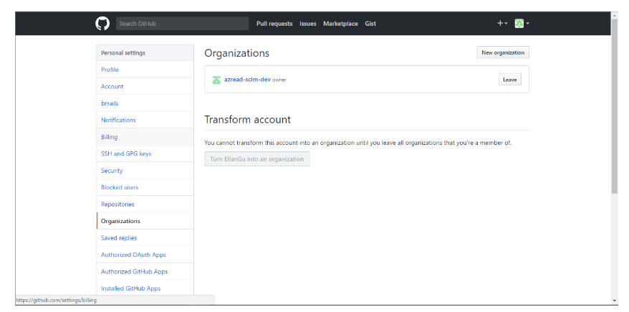
Getting Started
For Paved Path Providers:
For Custom IdPs:
Log in to your IdP's administrative console.
Enable SCIM provisioning for GitHub Enterprise Cloud.
Provide your GitHub organization SCIM base URL and bearer token as specified in your IdP's configuration instructions.
Implement SCIM integration by using the GitHub SCIM REST API.
Authenticate requests using a personal access token with the required scope.
Test the integration using sample SCIM requests.
Key Benefits of SCIM Integration
Provisioning: Automatically create accounts.
Updates: Synchronize roles and departments.
Deprovisioning: Remove access promptly upon user exit.
Notes:
To automate user and group provisioning in GitHub Enterprise Cloud, you can leverage SCIM—either via a native IdP integration or a custom implementation.
For Supported Providers:
Log into your IdP’s admin console (Okta, Azure AD, OneLogin, Ping Identity, or Google Workspace).
Enable SCIM provisioning in the GitHub application settings.
Copy GitHub’s SCIM base URL and bearer token into your IdP configuration so it can authenticate and push changes.
This setup creates a one‑way sync from your corporate directory to GitHub, handling user creation, updates, and removal automatically.
For Custom IdPs:
Use GitHub’s SCIM REST API directly—no native integration required.
Authenticate with a Personal Access Token that has the admin:org and scim scopes.
Test your integration by issuing sample requests (e.g., POST /scim/v2/Users) to verify user creation, updates, and deletions. While this approach requires a bit more scripting, it gives you complete control over how your directory maps to GitHub accounts and teams.
Key Benefits of SCIM Integration:
Provisioning: New employees are automatically created in GitHub when added to your IdP—no manual onboarding.
Updates: Role changes and department moves in your directory instantly propagate to GitHub team memberships and permissions.
Deprovisioning: When a user leaves, SCIM removes their access promptly, reducing the risk of orphaned accounts and ensuring compliance with offboarding policies.
By implementing SCIM—natively or via API—you eliminate manual user management, keep your GitHub org in sync with your corporate directory, and maintain strict, automated control over account lifecycle events.

Slide 21

SCIM vs. Manual User Management
Implementing SCIM offers significant advantages over manual user management, especially in terms of efficiency, security, and scalability.
Comparison of SCIM and Manual User Management:
Aspect | SCIM-Based Management | Manual User Management
Automation | Automates provisioning and deprovisioning | Manual intervention required
Consistency | Standardized user data across systems | Risk of inconsistencies
Security | Timely deactivation of access | Delayed or missed revocations
Scalability | Scales with large user bases | Cumbersome at scale
Compliance | Helps meet policy and audit requirements | Harder to track and report
By adopting SCIM, organizations can streamline their user management processes, reduce administrative overhead, and enhance security measures. GitHub's support for SCIM further simplifies integrating user management between identity providers and GitHub organizations, ensuring a seamless and secure experience.
Notes:
When it comes to keeping your GitHub organization’s user data in sync with your corporate directory, you have two choices: automate with SCIM or handle everything by hand. Here’s how they compare:
Automation
SCIM: Automatically provisions new users and deprovisions departed ones based on your IdP data—no human intervention needed.
Manual: Every onboard or offboard action requires an administrator to log into GitHub and add or remove accounts one by one.
Consistency
SCIM: Your user attributes—names, emails, group memberships—are standardized across all systems, eliminating typos or mismatched roles.
Manual: It’s easy to introduce errors or omissions when copying data by hand, leading to inconsistent profiles or forgotten permissions.
Security
SCIM: Access is revoked immediately when a user leaves your directory, closing gaps that attackers could exploit.
Manual: Delays or oversights in manual deprovisioning can leave stale accounts with lingering access.
Scalability
SCIM: Whether you have 10 users or 10,000, SCIM scales seamlessly—your provisioning scripts handle the growth automatically.
Manual: As headcount rises, managing each user by hand becomes increasingly time‑consuming and error‑prone.
Compliance
SCIM: Automated records of provisioning and deprovisioning events help you demonstrate adherence to policies and audits.
Manual: Tracking manual changes and providing audit evidence requires extra logging or reports, adding administrative overhead.
By adopting SCIM‑based management, you gain a reliable, efficient, and secure approach to user lifecycle management—freeing your admins to focus on strategic tasks rather than repetitive account maintenance.

Slide 22
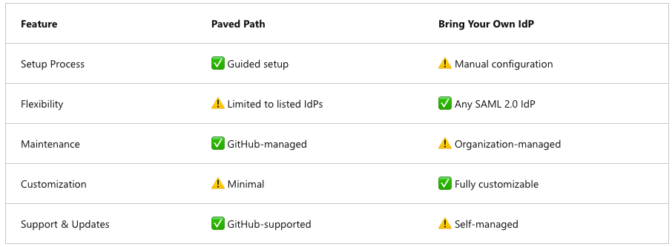
Comparing IdP Integration Paths
Notes:
When you integrate your identity provider with GitHub Enterprise Cloud, you have two main approaches:
Paved Path:
Setup Process: Guided, clicks‑through setup for officially supported IdPs (Okta, Azure AD, etc.).
Maintenance: Managed by GitHub, with automatic updates and support.
Flexibility & Customization: Limited to the list of supported providers and minimal custom options.
Support & Updates: Fully supported by GitHub.
Bring Your Own IdP (BYO):
Setup Process: Manual configuration using the SCIM or SAML APIs, requiring you to supply metadata and manage certificates.
Maintenance: You own the integration—updating configs, rotating keys, and troubleshooting.
Flexibility & Customization: Works with any SAML 2.0 IdP and allows full customization to fit your in‑house directory.
Support & Updates: You’re responsible for upkeep; GitHub does not automatically update custom integrations.
When to choose which:
If you use a supported IdP and want fast, low‑overhead setup with GitHub handling updates, the Paved Path is ideal.
If you need to integrate a nonstandard or highly customized IdP, or require specific SCIM flows, the BYO route gives you that flexibility—at the cost of additional configuration and maintenance effort

Slide 23
Managing Identities and Access
Configuring SAML SSO for Your Organization | Managing Authorized Credentials | Viewing and Managing Active SAML Sessions
SAML SSO URL Integrate your IdP with GitHub to enable SAML SSO. Configure your IdP to recognize GitHub as a service provider and set up the necessary trust relationships. 2. Public Certificate Once the IdP is connected, enable SAML SSO for your organization. This can be done through the GitHub Enterprise settings, where you can specify the IdP details and configure SSO settings. 3. IdP Metadata After enabling, you can enforce SAML SSO, requiring all members to authenticate via the IdP to access organization resources. This step enhances security by ensuring that only authenticated users can access sensitive information. | After configuring SAML SSO, it's essential to manage authorized credentials like personal access tokens and SSH keys: Personal Access Tokens To use a personal access token with an organization that uses SAML SSO, you must authorize the token. This process involves linking the token to your IdP account, ensuring that the token is valid for accessing organization resources. SSH Keys Similarly, to use an SSH key with an organization that uses SAML SSO, you must authorize the key. This authorization links the SSH key to your IdP account, allowing secure access to repositories and other resources. | GitHub allows you to view and manage your active SAML sessions: View Active Sessions You can see your active SAML sessions in your GitHub settings, providing visibility into your current authenticated sessions. Revoke Sessions If necessary, you can revoke active sessions to maintain security, ensuring that unauthorized access is promptly addressed.
Notes:
Setting up SAML SSO requires three key elements:
SAML SSO URL – This is the endpoint your IdP provides that GitHub uses to initiate authentication.
Public Certificate – A certificate from your IdP that GitHub uses to verify that authentication messages are legitimate.
IdP Metadata – This includes information that helps GitHub trust your identity provider and establish a secure relationship.
To configure this:
Go to GitHub Enterprise settings, and navigate to your organization’s security settings.
Enter your SAML SSO URL and certificate.
Use the “Test SAML configuration” tool before saving.
Once set up, you can enforce SAML SSO, which means all users must authenticate via your IdP to access organizational resources—further tightening security.
Once SAML SSO is enforced, it’s critical to manage authorized credentials such as:
Personal Access Tokens (PATs): These must be linked to your IdP account to remain valid. Users can still use PATs to interact with GitHub APIs—but only if authorized through the IdP.
SSH Keys: Just like PATs, SSH keys must be authorized to be used with organizations that have SAML SSO enabled. This ensures only verified keys can be used to access repos.
This additional step ensures even non-browser-based access is secure and linked to authenticated identities.
GitHub also lets users and administrators view and manage active SAML sessions.
View Sessions: In your GitHub user settings, you can see your current SAML-authenticated sessions.
Revoke Sessions:
If you suspect misuse or a device has been lost, you can manually revoke access, immediately ending the session and protecting your data.
These tools give users real-time visibility and control over their authenticated access to GitHub resources.

Slide 24
GitHub Membership Considerations
Type | Consideration
GitHub Instance Membership | - Access to public repositories - Create personal projects - Public profile visibility
Organization Membership | - Role-based internal access - Profile visible to org admins - May affect billing
Multiple Organization Memberships | - Different roles across orgs - Broader resource access - Complex permission and billing - Requires strict governance
Notes:
When planning your GitHub governance model, it’s important to understand the different levels of membership and their implications:
GitHub Instance Membership (Personal Account)
Every user starts with a personal GitHub account, which grants them immediate access to all public repositories and the ability to create private or public personal projects.
Their profile is visible to the world—contributions, followers, stars—all form part of their public reputation.
There’s no organization‑level billing impact, since personal accounts are billed separately or use the Free tier.
Organization Membership
When a user joins an organization, they gain role‑based access to that org’s private repositories and resources—based on the permissions you assign (Read, Triage, Write, Maintain, Admin).
Their personal profile remains public, but organization owners and admins can see their membership status and activity within the org.
Adding paid seats for organization members can affect your billing, so it’s important to manage invitations and removals promptly.
Multiple Organization Memberships
It’s common for users to belong to several organizations—each with different roles and permission levels—allowing them to collaborate on a wider range of projects.
However, this breadth of access also brings complexity: you must track which roles and billing seats apply in each org, and ensure consistent governance across them.
Establish clear policies for offboarding, permission reviews, and role assignments to prevent privilege creep and control costs as your enterprise grows.

Slide 25
Team synchronization
If your company uses Microsoft Entra ID or Okta as your identity provider (IdP), you can manage GitHub team membership through team synchronization. When enabled, team sync automatically reflects changes in IdP groups on GitHub—reducing the need for manual updates or custom scripts. This centralized approach simplifies onboarding, permissions management, and access revocation.
Feature | Description
Sync Users | Keep GitHub Teams aligned with IdP (for example, Active Directory) group membership
Sync on New Team | Automatically populate teams at creation
Custom Team Mapping | Use syncmap.yml to define custom mappings between team slugs and group names
Dynamic Config | Use a settings file to derive sync settings from your directory structure
Notes:
Team synchronization lets you leverage your existing IdP groups—whether in Microsoft Entra ID, Okta, or another supported provider—as the source of truth for GitHub team membership. Once enabled, any change in your directory—adding or removing users from an AD group, for example—automatically flows into the corresponding GitHub team, eliminating manual invites, scripts, or out‑of‑sync permissions.
Key capabilities include:
Sync Users: Keeps teams aligned continuously with your IdP group memberships.
Sync on New Team: Automatically populates a newly created GitHub team with its IdP members, so no one gets left out.
Custom Team Mapping: By defining a syncmap.yml, you can map IdP group names to GitHub team slugs, supporting non‑standard naming conventions.
Dynamic Config: A settings file can derive sync rules from your directory’s structure—ideal for large or nested team hierarchies.
By centralizing team management in your IdP and letting GitHub mirror those groups, you streamline onboarding, enforce least privilege seamlessly, and ensure that access is revoked immediately when someone leaves an AD group—keeping your organization both secure and easy to administer.

Slide 26

Team Synchronization Use Cases
Team sync is ideal for enterprises looking to streamline membership management within GitHub organizations. Admins can map GitHub teams to IdP groups and manage memberships automatically.
This is useful for:
Onboarding new employees
Adjusting access as users move between teams
Removing users who leave the organization
To use team sync, your IdP admin must enable SAML SSO and SCIM.
Notes:
Team sync shines in enterprises with complex, dynamic team structures. By mapping GitHub teams directly to your IdP groups, you eliminate manual membership updates and ensure that team rosters stay accurate.
Onboarding new employees: As soon as HR adds a hire to the appropriate AD or Okta group, they automatically gain access to the corresponding GitHub teams—no invitation step required.
Adjusting access on role changes: When someone switches departments or projects, moving them between IdP groups instantly updates their GitHub team memberships, ensuring they only see the repositories relevant to their new role.
Offboarding departed users: Removing a user from your corporate directory immediately revokes their GitHub team access, cutting off permissions in one atomic action and reducing the risk of orphaned accounts.
Warning: To leverage team synchronization, you must first enable SAML SSO and SCIM provisioning in your identity provider. These prerequisites ensure secure, automated group membership management across your entire GitHub organization.

Slide 27
Enterprise Managed Users
If you're using Enterprise Managed Users in GitHub Enterprise Cloud, all members are provisioned through your IdP. Users don't self-manage GitHub accounts and can't access resources outside the enterprise.
With this model, you can:
Manage organization/team membership directly through your IdP
Ensure GitHub users are enterprise-scoped and isolated
For more, see Getting started with GitHub Enterprise Cloud.
Notes:
When you adopt Enterprise Managed Users in GitHub Enterprise Cloud, you hand over full account provisioning to your identity provider—no more manual invites or self‑service account creation. EMUs are scoped exclusively to your enterprise, meaning these accounts can’t fork off into external organizations or hold personal repos.
Key benefits include:
Centralized Membership: All organization and team assignments flow directly from your IdP groups, so changes in HR or IT systems automatically reflect in GitHub—onboarding, role changes, and offboarding happen seamlessly.
Isolation & Compliance: EMU accounts exist only within your enterprise boundary, preventing accidental data exposure to external collaborators and simplifying license management.
By using EMUs, you ensure that every GitHub user is managed under your corporate policies and cannot stray outside the secure perimeter of your enterprise. For step‑by‑step setup instructions, refer to the “Getting started with GitHub Enterprise Cloud” guide

Slide 28
Team Synchronization vs. SCIM for GHES
In GitHub Enterprise Server (GHES), managing user access and team memberships can be achieved through various methods, including team synchronization and System for Cross-domain Identity Management (SCIM). Understanding these methods is essential for effective administration.
Notes:
In GitHub Enterprise Server, you have two complementary ways to keep your team memberships in sync with your corporate directory: Team Synchronization and SCIM provisioning.

Slide 29
Team Synchronization vs. SCIM for GHES
Team Sync in GHES
Team Synch Configuration
Team synchronization allows you to link GitHub teams with groups in your Identity Provider (IdP). This integration ensures that any changes in the IdP group—such as adding or removing members—are automatically reflected in the corresponding GitHub team. This approach streamlines team management by centralizing user access control within the IdP.
However, it's important to note that team synchronization isn't a user provisioning service and doesn't invite non-members to join organizations in most cases. Therefore, a user will only be successfully added to a team if they're already an organization member.
Consider the following scenario to understand how team synchronization works in practice:
When Azure AD group "DevOps Engineers" maps to GitHub team "DevOps"
When Alice is added to the IdP group → automatically added to the GitHub team
When she leaves the group → automatically removed from the team
Enable Security Assertion Markup Language(SAML) Single Sign-On(SSO) and SCIM in your IdP.
Map GitHub teams to IdP groups via GitHub UI or API.
Changes in group membership sync automatically to GitHub.
Supported IdPs:
Microsoft Entra ID: Requires permissions for profile reading and directory access.
Okta: Requires SAML SSO, SCIM, tenant URL, and Single Sign-on for Web Systems(SSWS) token with read-only admin access.
Notes:
Team Synchronization
What it does: Links GitHub teams to your IdP groups so that when you add or remove users in your directory, those changes automatically flow into the matching GitHub team.
Key limitation: It does not create new GitHub accounts or invite non‑members—users must already belong to the organization before they can be synced into a team.
Practical example: If you map your Azure AD “DevOps Engineers” group to the GitHub team “DevOps,” adding Alice to the AD group immediately adds her to the GitHub team, and removing her from AD removes her from the team.
SCIM Integration
What it does: Automates user provisioning in GHES—creating, updating, and deprovisioning user accounts directly from your IdP using the SCIM 2.0 API. This fills the gap left by team sync, allowing new users to be onboarded automatically.
Configuration prerequisites: You must enable SAML SSO and SCIM provisioning in your identity provider.
Supported IdPs & Requirements
Microsoft Entra ID: Needs directory‑read permissions to sync profiles and group memberships.
Okta: Requires SAML SSO, SCIM enabled, your tenant URL, and an SSWS token with read‑only admin scope.
By combining SCIM for account provisioning with team synchronization for group membership, you achieve a fully automated, end‑to‑end identity and access management workflow in GHES—minimizing manual steps and ensuring your GitHub teams always reflect your corporate structure.

Slide 30
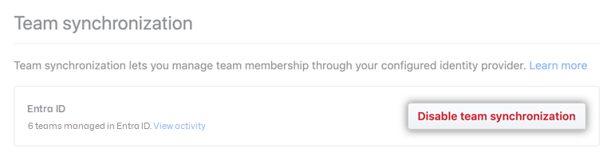
Disable Team Sync
To disable:
Navigate to Settings > Organization security
Click Disable team synchronization
Note: Disabling sync removes users from teams if they were added via IdP mapping.
Notes:
If you need to turn off automated team sync—perhaps during a directory migration or troubleshooting—you can do so quickly:
Go to Settings → Organization security in your GitHub organization.
Click Disable team synchronization.
This action stops future updates from your IdP group changes, but it doesn’t remove existing members from teams. You can re‑enable sync at any time once you’re ready to resume automatic membership management.

Slide 31
SCIM in GHES
SCIM is an open standard protocol designed to automate the exchange of user identity information between identity domains and IT systems. In the context of GHES, SCIM enables administrators to provision, update, and deprovision user accounts directly through the GitHub API. This means you can create, update, and delete user accounts, and sync group information to map GitHub team memberships.
SCIM is useful for managing user lifecycles at scale, ensuring that user data remains consistent across systems.
Consider the following scenario to understand how SCIM works in practice:
Okta SCIM integration provisions GitHub users automatically
Bob is added to Okta → GitHub account is provisioned
Bob changes roles → access and teams update
Bob leaves → account is deprovisioned
Key Benefit: Full automation for account lifecycle management.
Notes:
SCIM—System for Cross‑domain Identity Management—is the industry standard for automating user identity synchronization between your corporate directory and GitHub Enterprise Server. By implementing SCIM, you can provision new user accounts, update profile attributes, assign group memberships, and deprovision accounts—all through API calls rather than manual invites.
Consider an Okta integration: when you add Bob to the “Developers” group in Okta, SCIM automatically calls the GitHub API to create Bob’s account in GHES and assign him to the appropriate teams. If Bob’s role changes, his GitHub permissions update in real time; when he leaves the company, SCIM deprovisions his account entirely.
This full lifecycle automation ensures that your GitHub user data stays consistent with your source of truth, reduces human error, and accelerates both onboarding and offboarding at scale. In short, SCIM gives you hands‑off, reliable identity management for your entire enterprise.

Slide 32
Team Sync vs. Group SCIM
GitHub supports two primary identity integration approaches:
Feature | Team Sync - syncing group membership to GitHub teams | Group SCIM - full lifecycle management of users and groups
Focus | Team-level mapping | User and group provisioning
Setup | Manual group-to-team mapping | Automated via IdP SCIM config
Automation Level | Syncs group membership only | Full lifecycle automation
Ideal Use Case | GitHub Teams management | Large orgs with high user turnover
Deprovisioning | Manual or IdP-group dependent | Fully automated
Identity Model | Classic | Managed Users
Choosing the Right Approach
The choice between Team Sync and Group SCIM depends on your organization’s needs, size, and existing identity management infrastructure:
Choose Team Sync if you need to manage repository access by teams or if GitHub Teams is core to your workflow.
Choose Group SCIM if you want to automate the full user lifecycle and enforce IdP‑based governance.
Notes:
GitHub offers two primary identity‑integration methods:
Team Sync focuses on syncing your existing IdP groups directly to GitHub teams. You manually map each group to a team, and any membership changes in your directory automatically update the team roster in GitHub. This is ideal when GitHub Teams are core to your workflow and you simply need to manage access by team.
Group SCIM extends far beyond team membership: it automates the entire user and group lifecycle. By configuring SCIM in your IdP, you can provision, update, and deprovision both accounts and group assignments without manual steps—perfect for large organizations with high user turnover or strict IdP‑driven governance requirements.
Here’s how they differ at a glance:
Setup: Team Sync uses manual group‑to‑team mapping, whereas Group SCIM is configured once via your IdP’s SCIM settings.
Automation: Team Sync only syncs memberships; SCIM handles full user and group provisioning.
Deprovisioning: Team membership removal depends on your IdP group for Team Sync, but SCIM automatically removes accounts and group assignments.
Identity Model: Team Sync works with classic GitHub accounts, while Group SCIM pairs with Enterprise Managed Users for true enterprise‑scoped identities.
Choosing the Right Approach:
Choose Team Sync if your goal is simply to keep GitHub Teams populated from your IdP and GitHub Teams are central to how you organize work.
Choose Group SCIM if you need end‑to‑end automation of user lifecycles, from onboarding through offboarding, and require unified, IdP‑based governance across your enterprise.

Slide 33
Usage Limits
When using team synchronization, observe these limits:
Max members per team: 5,000
Max members per organization: 10,000
Max teams per organization: 1,500
Exceeding these may result in performance issues or sync failures.
Notes:
When you enable Team Sync, it relies on your GitHub teams mirroring directory groups, but there are hard limits to keep performance optimal. Each team can contain up to 5,000 members, and an organization can have up to 10,000 total members. Additionally, you can create up to 1,500 teams per organization.
If you exceed these thresholds, you may experience slow syncs, timeouts, or even failures to update memberships. For very large enterprises, consider partitioning your user base across multiple organizations or combining Team Sync with SCIM‑based provisioning to distribute load and maintain reliability. Always monitor your team and org sizes, and plan your identity‑management strategy to stay within these limits for a smooth, performant experience.

Slide 34
Knowledge Checks
Notes:
You’ve now explored GitHub’s enterprise authentication and access‑management features—from SAML SSO and 2FA to SCIM provisioning and Team Sync. It’s time to put that knowledge into practice with a short knowledge check.
Over the next few questions, you’ll review key concepts like enforcing SAML SSO scopes, choosing between Team Sync and SCIM, and understanding audit‑log use cases.
Take a moment to consider each scenario carefully, and select the best answer based on what you’ve learned

Slide 35
Knowledge Check: Authenticate and authorize user identities on GitHub
1 of 4
What type of user authentication is used to verify a user identity against a known identity provider?
Two-factor authentication (2FA)
Time-based One-time Password (TOTP)
SAML Single Sign-on (SAML SSO)
Short Message Service (SMS)
© Copyright Microsoft Corporation. All rights reserved.
Notes:
1. What type of user authentication is used to verify a user identity against a known identity provider?
a. Two‑factor authentication (2FA)
Explanation: 2FA adds an extra verification step to a login, but it doesn’t itself authenticate you against an external identity provider.
b. Time‑based One‑time Password (TOTP)
Explanation: TOTP is a method for generating one‑time codes as a second factor, not a protocol for verifying your identity with an IdP.
c. SAML Single Sign‑on (SAML SSO)
Explanation: SAML SSO is the protocol that redirects authentication to a trusted identity provider and verifies the user’s identity before granting access to GitHub.
d. Short Message Service (SMS)
Explanation: SMS delivers one‑time codes as a second factor, but it does not involve an external identity provider for primary authentication.
Correct answer: c

Slide 36
Knowledge Check: Authenticate and authorize user identities on GitHub
2 of 4
You're an admin and want to enable team synchronization for your organization. What installation permissions do you need to configure team synchronization for Microsoft Entra ID?
Provide the tenant URL
Read all users' full profiles
Generate a valid Single Sign-on for Web Systems (SSWS) token
Enable SAML Single Sign-on (SSO)
© Copyright Microsoft Corporation. All rights reserved.
Notes:
Which installation permission do you need for Microsoft Entra ID team synchronization?
a. Provide the tenant URL
Explanation: While you’ll supply your tenant’s endpoint when configuring SCIM, this isn’t a permission—just a configuration detail.
b. Read all users’ full profiles
Explanation: Correct. The Microsoft Entra ID integration requires Directory Read permissions (e.g., User.Read.All) so GitHub can query group membership and user attributes.
c. Generate a valid Single Sign‑On for Web Systems (SSWS) token
Explanation: The SSWS token is specific to Okta’s SCIM integration, not Microsoft Entra ID.
d. Enable SAML Single Sign‑on (SSO)
Explanation: SAML SSO is a prerequisite for team sync, but it’s a configuration step, not an IdP permission.
Correct answer: b Read all users’ full profiles.

Slide 37
Knowledge Check: Authenticate and authorize user identities on GitHub
3 of 4
Where does a user authenticate after enabling SAML Single sign-on?
With a GitHub login
With the organization credentials
With the Identity Provider (IdP)
© Copyright Microsoft Corporation. All rights reserved.
Notes:
Where does a user authenticate after enabling SAML Single sign-on?
a. With a GitHub login
Explanation: After SAML SSO is enforced, users no longer enter a separate GitHub username/password—they’re redirected away from GitHub for primary authentication.
b. With the organization credentials
Explanation: “Organization credentials” on GitHub still rely on identities managed by an external IdP under SAML SSO; there isn’t a separate org‑specific login prompt.
c. With the Identity Provider (IdP)
Explanation: SAML SSO redirects users to your corporate IdP (e.g., Okta, Azure AD) to verify their identity before granting access to GitHub resources.
Correct answer: c

Slide 38
Knowledge Check: Authenticate and authorize user identities on GitHub
4 of 4
What two-factor authentication method supports the secure backup of your authentication codes in the cloud?
Time-based One-time Password (TOTP)
Short Message Service (SMS)
Security Key
© Copyright Microsoft Corporation. All rights reserved.
Notes:
What two‑factor authentication method supports the secure backup of your authentication codes in the cloud?
a. Time‑based One‑time Password (TOTP)
Explanation: Many TOTP authenticator apps—like Authy—offer encrypted cloud backup of your shared secrets, so you can recover your codes across devices.
b. Short Message Service (SMS)
Explanation: SMS delivers one‑time codes via text messages but does not provide a backed‑up, recoverable code store.
c. Security Key
Explanation: Security keys store credentials locally on a hardware device and don’t support cloud backup of secrets.
Correct answer: a

Slide 39
Summary
In this module, you learned about allowing access to your users, and how the authentication systems available for your GitHub organization help keep your sensitive data secure. You also learned about auditing which users and teams have access to the repositories in your organization. Securing who has access to your organization ensures that only the users who legitimately need access to your organization's data have it.
Learn more
Here are some links to more detailed information on the topics we discussed in this module:
Managing SAML single sign-on for your organization - GitHub Docs
Viewing and managing a member's SAML access to your organization - GitHub Docs
Preparing to require two-factor authentication in your organization - GitHub Docs
Authorizing a personal access token for use with SAML single sign-on - GitHub Docs
Authorizing an SSH key for use with SAML single sign-on - GitHub Docs
Synchronizing a team with an identity provider - GitHub Docs
Notes:
In this module, you saw how to balance seamless developer access with robust security controls in your GitHub Enterprise environment. We began by comparing single‑factor username/password logins to stronger methods—SAML SSO for centralized, IdP‑backed authentication, and 2FA (via TOTP, SMS, or security keys) to add a critical second factor.
Next, we covered identity provider integrations:
Team Sync to mirror your IdP groups directly into GitHub teams, and
SCIM for full user and group provisioning, onboarding, updates, and deprovisioning at scale.
You learned which major IdPs GitHub supports out of the box, as well as how to build custom SCIM connections if needed. We also reviewed how to enforce and audit these settings—using the People tab, organization Security settings, and the Audit Log APIs—to verify compliance and track access events.
Finally, we examined how these tools combine to create a secure, automated lifecycle: strong authentication gates, least‑privilege authorization, automated team membership, and comprehensive audit trails.
By implementing SAML SSO, enforcing 2FA, leveraging SCIM and Team Sync, and monitoring via audit logs, you can ensure that only the right users have access, that their permissions stay up to date, and that any changes are fully traceable.
Use these practices to build a GitHub environment that’s both developer‑friendly and enterprise‑secure—protecting your code, your data, and your organization from credential‑related threats.”

